Slide 1
RSA Scheme
朱萍(Ping Zhu)
pzhubupt@gmail.com
School of Science, Beijing University of
Posts and Telecommunications

Slide 2
RSA cryptosystem [Rivest, Shamir, Adleman 1977;
Commun. ACM 21 (1978), 120-126]
Key generation:
  Choose two large prime numbers p, q
    Say, 1024 bits each (need primality testing, too)
  Let n = pq; then ϕ(n) = (p–1)(q–1)
  Choose small e < n such that e is relatively prime to ϕ(n)
  Compute unique d such that ed ≡ 1 mod ϕ(n)
  Public key: (e, n); private key: d
Encryption of m: E(m) = m^{e} mod n
  Modular exponentiation by repeated squaring
Decryption of c: D(y) = y^{d} mod n

Slide 3
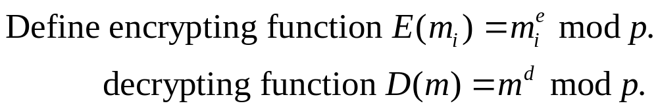
Recall: Pohlig-Hellman expon. cipher
Pohlig and Hellman, 1976.
  p: an odd prime
  m: the numeric equivalent (2 digits for every letter) of the plaintext
  Subdivide m into blocks mi s.t. 0<mi<p.
  e: an integer, 0<e<p, (e,p-1)=1

Slide 4
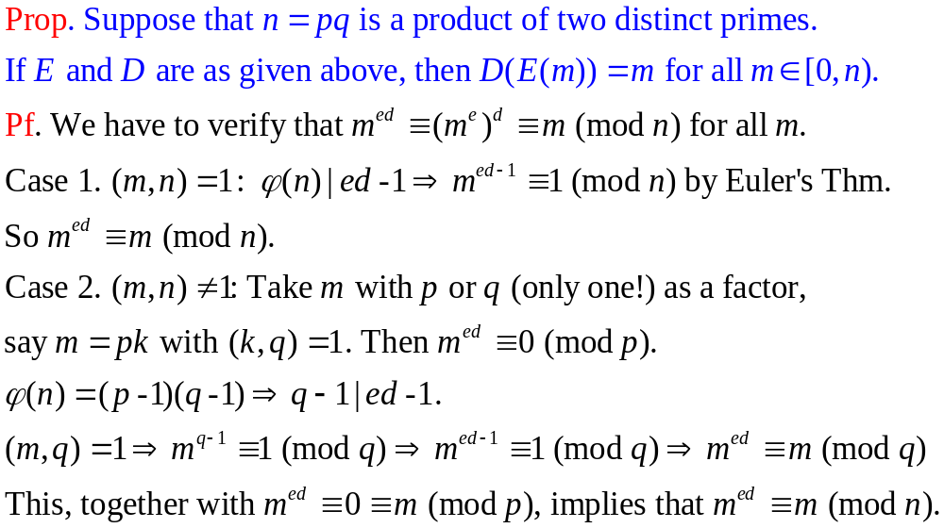
Why does RSA decryption work

Slide 5
Why is RSA secure
RSA problem: Given n=pq, c, and e such that
(e,(p-1)(q-1))=1, find m such that m^{e}=c mod n
  i.e., recover m from ciphertext c and public key (n,e) by taking e^{th} root of c (belief: one-way function)
  There is no known efficient algorithm for doing this
Factoring problem: Given positive integer n, find primes p₁,…, p_{k} such that n=p₁^{e1}p₂^{e2}…p_{k}^{ek}
If factoring is easy, then RSA problem is easy, but there is no known reduction from factoring to RSA (belief: determining d from e is equivalent to factoring n)
  It may be possible to break RSA without factoring n

Slide 6
Why is RSA secure (cont.)
Prop. n=pq: a product of two distinct primes. Then computing ϕ(n) is equivalent to factoring n.
Pf.
  If the factorization of n is known, then ϕ(n) = (p-1)(q-1).
  Conversely, if we know n and ϕ(n), then write q=n/p and substitute this in the formula for ϕ(n):
  ϕ(n) = (p-1)(q-1)=(p-1)(n/p-1).
  Simplifying this equation shows that p is a root of the quadratic equation p² – (n - ϕ(n) + 1)p + n = 0.
  It is easy to see that q is also another root of the quadratic equation. Hence we have shown that computing ϕ(n) is equivalent to factoring n.

Slide 7
RSA Use
to encrypt a message m, the sender:
  obtains public key of recipient {e, n}
  computes: c=m^{e} mod n, where 0≤m<n
to decrypt the ciphertext c, the receiver:
  uses his/her private key {d, p, q}
  computes: m=c^{d} mod n
note that the message m must be smaller than the modulus n (block if needed)

Slide 8
RSA use (cont.)
Exponentiation
  We need to do it fast
Factorization
  Believed to be difficult (security is here)
Finding prime numbers and testing primality
  Rabin-Miller test
  New polynomial time algorithm
    http://mathworld.wolfram.com/news/2002-08-07_primetest/

Slide 9
RSA use (cont.)
2²⁵⁶ mod 7
  Don’t do (a × a × a… × a) 256 times and mod by 7
(a × b) mod p = (a mod p × b mod p) mod p
  256 = 2⁸, (((((((a²) ²) ²) ²) ²) ²) ²) ² and mod 7 each time you perform a square
p and q must be large for security
e, the encryption exponent, does not have to be that large (2¹⁶ + 1 = 65537 is good; cf. http://en.wikipedia.org/wiki/65537#In_mathematics )
d, the decryption exponent, needs to be sufficiently large (512 to 2048 bits)

Slide 10
Example: Confidentiality
Take p = 7, q = 11, so n = 77 and ϕ(n) = 60
Alice chooses e = 17, making d = 53
Bob wants to send Alice secret message HELLO (07 04 11 11 14)
  07¹⁷ mod 77 = 28
  04¹⁷ mod 77 = 16
  11¹⁷ mod 77 = 44
  11¹⁷ mod 77 = 44
  14¹⁷ mod 77 = 42
Bob sends 28 16 44 44 42
Encipher message in blocks considerably larger than the example here

Slide 11
Example: Confidentiality (cont.)
Alice receives 28 16 44 44 42
Alice uses private key, d = 53, to decrypt message:
  28⁵³ mod 77 = 07
  16⁵³ mod 77 = 04
  44⁵³ mod 77 = 11
  44⁵³ mod 77 = 11
  42⁵³ mod 77 = 14
Alice translates message to letters to read HELLO
  No one else could read it, as only Alice knows her private key and that is needed for decryption

Slide 12




Digital Signatures: Basic Idea
public key
?
public key
private key
Alice
Bob
Given: Everybody knows Bob’s public key
Only Bob knows the corresponding private key
Goal: Bob sends a “digitally signed” message
    To compute a signature, must know the private key
    To verify a signature, enough to know the public key

Slide 13
RSA Signatures
Public key is (e, n), private key is d
To sign message m: s = m^{d} mod n
  Signing and decryption are the same operation in RSA
  It’s infeasible to compute s on m if you don’t know d
To verify signature s on message m:
s^{e} mod n = (m^{d})^{e} mod n = m
  Just like encryption
  Anyone who knows e and n (public key) can verify signatures produced with d (private key)

Slide 14
Example: Authentication
Take p = 7, q = 11, so n = 77 and ϕ(n) = 60
Alice chooses e = 17, making d = 53
Alice wants to send Bob message HELLO (07 04 11 11 14) so Bob knows it is what Alice sent (authenticated)
  07⁵³ mod 77 = 35
  04⁵³ mod 77 = 09
  11⁵³ mod 77 = 44
  11⁵³ mod 77 = 44
  14⁵³ mod 77 = 49
Alice sends 35 09 44 44 49

Slide 15
Example: Authentication (cont.)
Bob receives 35 09 44 44 49
Bob uses Alice’s public key, e = 17, n = 77, to decrypt message:
  35¹⁷ mod 77 = 07
  09¹⁷ mod 77 = 04
  44¹⁷ mod 77 = 11
  44¹⁷ mod 77 = 11
  49¹⁷ mod 77 = 14
Bob translates message to letters to read HELLO
  Alice sent it as only she knows her private key, so no one else could have enciphered it

Slide 16
Example: Both
Alice wants to send Bob message HELLO both enciphered and authenticated
  Alice’s keys: public (17, 77); private: 53
  Bob’s keys: public: (37, 77); private: 13
Alice enciphers HELLO (07 04 11 11 14):
  (07⁵³ mod 77)³⁷ mod 77 = 07
  (04⁵³ mod 77)³⁷ mod 77 = 37
  (11⁵³ mod 77)³⁷ mod 77 = 44
  (11⁵³ mod 77)³⁷ mod 77 = 44
  (14⁵³ mod 77)³⁷ mod 77 = 14
Alice sends 07 37 44 44 14

Slide 17
Example: Both (cont.)
Bob receives 07 37 44 44 14
Bob uses his private key and Alice’s public key, e = 17, n = 77, to decrypt message:
  (07¹³ mod 77) ¹⁷ mod 77 = 07
  (37¹³ mod 77) ¹⁷ mod 77 = 04
  (44¹³ mod 77) ¹⁷ mod 77 = 11
  (44¹³ mod 77) ¹⁷ mod 77 = 11
  (14¹³ mod 77) ¹⁷ mod 77 = 14
Bob translates message to letters HELLO
  Alice sent it as only she knows her private key
  No one else could read it, as only Bob knows his private key and that is needed for decryption

Slide 18
Integrity in RSA Encryption
Plain RSA does not provide integrity
  Given encryptions of m₁ and m₂, attacker can create encryption of m₁⋅m₂
    (m₁e) ⋅ (m₂e) mod n = (m₁⋅m₂)^{e} mod n
  Attacker can convert m into m^{k} without decrypting
    (m^{e})^{k} mod n = (m^{k})^{e} mod n
In practice, OAEP(最优非对称加密填充 ) is used: instead of encrypting m, encrypt m⊕g(r); r⊕h(m⊕g(r))
  r is random and fresh, g and h are hash functions
  Resulting encryption is plaintext-aware: infeasible to compute a valid encryption without knowing plaintext, if hash functions are “good” and RSA problem is hard

Slide 19

Attacks on RSA
Three approaches to attacking RSA:
  brute force key search (infeasible given size of numbers)
  mathematical attacks (based on difficulty of computing ϕ(n), by factoring modulus n)
  timing attacks (on running of decryption)
  D. Boneh, Twenty years of attacks on the RSA cryptosystem, Notices of the American Mathematical Society, Vol. 46, No. 2, pp. 203-213, 1999.

Slide 20
Attacks on RSA (cont.)
Mathematical approach takes 3 forms:
  factor n=pq, hence find ϕ(n) and then d
  determine ϕ(n) directly and find d
  find d directly
currently believe all equivalent to factoring
  have seen slow improvements over the years; biggest improvement comes from improved algorithm
  1024+ bit RSA secure except for dramatic breakthrough
Timing attacks developed in mid-1990’s
  exploit timing variations in operations and infer operand size based on time taken
  Countermeasures: use constant exponentiation time; add random delays
Notes:
See Stallings Table 9-3 for progress in factoring.
Best current algorithm is the “Generalized Number Field Sieve” (GNFS), which replaced the earlier “Quadratic Sieve” in mid-1990’s. Do have an even more powerful and faster algorithm - the “Special Number Field Sieve” (SNFS) which currently only works with numbers of a particular form (not RSA like). However expect it may in future be used with all forms. Numbers of size 1024+ bits look reasonable at present, and the factors should be of similar size

Slide 21
Advantages of public-key crypto
Confidentiality without shared secrets
  Very useful in open environments
  No “chicken-and-egg” key establishment problem
    With symmetric crypto, two parties must share a secret before they can exchange secret messages
Authentication without shared secrets
  Use digital signatures to prove the origin of messages
Reduce protection of information to protection of authenticity of public keys
  No need to keep public keys secret, but must be sure that Alice’s public key is really her true public key

Slide 22
Disadvantages of public-key crypto
Calculations are 2-3 orders of magnitude slower
  Modular exponentiation is an expensive computation
  Typical usage: use public-key cryptography to establish a shared secret; then switch to symmetric crypto
Keys are longer
  1024 bits (RSA) rather than 128 bits (AES-高级加密标准)
Relies on unproven number-theoretic assumptions

Slide 23
Exercises
1. A message is said to be fixed in the RSA system if E(m)=m. Show that if n, e, and d are as described in this section, the number of messages fixed by E is
(e-1, p-1)(d-1, q-1).
2. Modify the RSA system to design a multiparty cryptosystem, in which there are three keys. The goal is that a message encrypted with any one of the keys cannot be deciphered without the knowledge of the other two keys. The design of such a system could have applications to digital signature schemes where it is necessary to have the same document signed by more than one person.

